Slide 1



CLUB MELANIN
TRINITY

Slide 2

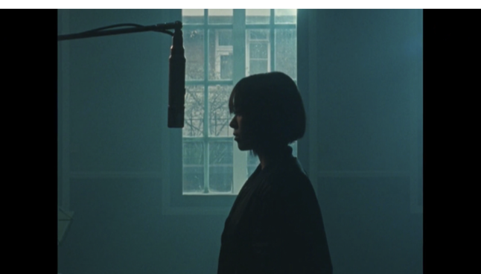
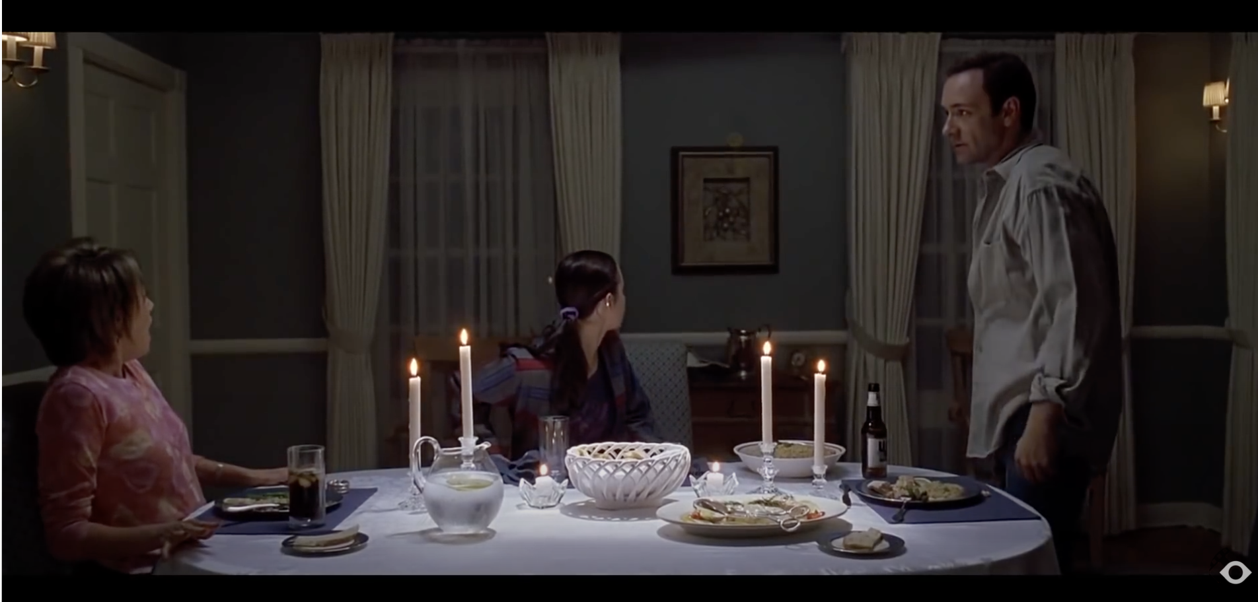
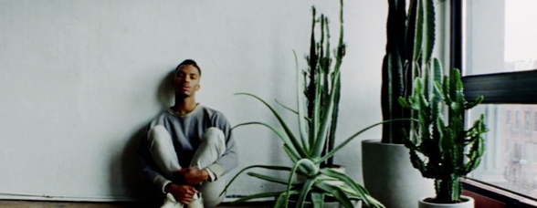
STORY
This video will be at a dinner table in a room with Trinity in the middle, one black male and white female person sitting on either end paying her no attention at all. It will be a long shot to allow for action to occur at the front of the table. A low dim/gloomy lighting will be used throughout to match the mood of the poem. It will be very clear throughout that ultimately Trinity feels very alone and excluded.

Slide 3
‘Sometimes i feel like my community does not always stand behind me’ - All at the table - first shot camera zooms in and out
We will capture a long shot that sets the mood – shows the artist being very blatantly ignored by the black and white actor at the table – they literally do anything but pay her any form of attention. Then she begins. This will act as if Trinity is the narrator giving the viewer an insight through her eyes of what life is like for her as a mix raced female.
Dark and moody in nature these performance shots - low key negative fill lighting techniques to empress the mood and feeling of isolation.
dark moody
Representatives of the community – something plain, same colour – all black
Giulio and Greta both talking

Slide 4
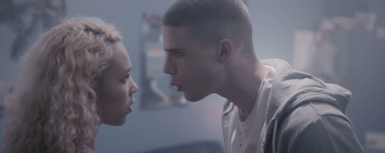
Black person mimes - you’re not black enough with her - cut to haks saying it to camera/trinity table in back and alone
This will be mimed in quite an aggressive and venomous way
Magic password - black and white person at the table get up from table and start dancing together in front of Trinity/black group and white group dancing, they come together then trinity comes in they scatter.
The combination of a charismatic performance with stylised art direction will keep our audience entertained throughout while serving the energy innate to the lyrics. It is clear that white people can easily get in with black people but Trinity can not due to her mix. We want to appeal to audiences young and old and we'll do this with our bold art direction and imaginative scenes. Very importantly, the dance will be seamlessly integrated into the scenes so we're exhibiting a video that grips the audience's attention while effortlessly. It's this balance of performance and creative storytelling that I've made such an integral part of my directing
Because I’m light skinned - she tries to join they look and walk away

Slide 5
‘The way the Dark skins..’ - group of friends come on to scene look excited to go to a party – dark skin friends do not get in they then leave scene looking sad behind trinity because they couldn’t get into the club at the same time a black person enters who is black person ‘shotting’ to a white person in a dress, exchange money looking around etc. other black people try to purchase, shotter walks away and ignores - this leads to fight between black and black person then the black and white person – ‘to those people blackness becomes a commodity.’
‘And on the inside’ - trinity speaking to us again
‘But those camera flashed aren't waking’ - two people at table head drop they fall asleep – greta is doing cup thing from get out camera is behind her and see giulio head drop.
‘If they were awakened’ - black person comes in trying to wake giulio up fail notice greta and fight
‘How people have been using blackness’ - they stop fighting stare at each other shake hands walk away
‘From the Egyptians’ - enter one black person and mixed person who start fighting – white person watching summons white person and dressed exactly the same and doing the same thing
‘Only once we work together’ - they stop stare walk off
Trinity stands says the rest of piece to end it
Yeah light skins are getting in – Luis not saying anything stood behind Trinity.

